Slide 1
DLA Disposition Services NASASP Conference​ ​
Casandra Gilbert
Reutilization, Transfer, Donation
July 2025

Slide 2
Overview
CONUS Regions
Disposal Overview
RTD Overview
RTD Updates
RTD Data
2

Slide 3
CONUS Regions
Beth Ford, Director
Cliff Serwe, Deputy
Northeast Region
Sites: 7, Offices: 2
WG: 125, GS: 132
Becky Watson, Director
Audrey Weber, Deputy
Southeast Region
Sites: 6, Offices:1
WG: 120, GS: 132
Jessie Parisano, Director
Vacant, Deputy
Mid-America Region
Sites: 6, Offices: 5
WG: 89, GS: 96
Chris Buchanan, Director
Luis Marroquin, Deputy
West Region
Sites: 7, Offices: 4
WG: 115 GS: 125
Notes:
Updated 06/04/2025
This slide identifies the CONUS Regions w/Sites & Authorized Personnel (based on GO 04-20).
CONUS – 4 Regions (West, Mid-America, Northeast, & Southeast)
Full service sites = 26
DEMIL centers = 2
Full-time field offices = 18
DSR-supported field offices = 28
Based on Network Optimization, we were able to balance the network to support the workload.

Slide 4







Disposal Overview
Generates Excess
Disposition Services Process
Screening Cycle
Physical or Electronic Turn-In to DLA Disposition Services
Unserviceable property downgraded to scrap
Serviceable property screened through RTD cycles
DEMIL required property screened for 14 days, followed by disposal processing
All non-reutilized property is dispositioned through useable or scrap sales contracts after screening
Authorities:
GSA regulations Part 102 of Title 41, CFR
DoD Manual 4160.21 “Defense Materiel Disposition”
Reutilization (14 Days)
DOD Internal Screening
DOD Special Programs
Foreign Military Sales
Transfer (21 Days)
Federal Agencies
Donation (5 Days)
State Agencies
RTD 2 – Last Chance (2 Days)
All Customers
Ultimate Disposal
Usable/Scrap Sales
Hazardous Sales/Service
Abandonment and Destruction
Up to 7 Days
Accumulation-
*DOD ONLY*
Days 1 - 14
Reutilization (R)
Days 15 –35
Last Chance RTD Screening
Days 41 -42
Transfer (T)
Donation (D)
Days 43 –60
Ultimate Disposal
Days 36 –40
Excess
Surplus
CONUS
Up to 7 Days
Accumulation
*DOD ONLY*
Days 1 - 21
Reutilization (R) and Transfer (T)
Days 22 –42
Donation (D)
Days 43 –60
Ultimate Disposal
OCONUS
Notes:
Slide updated 6/5/2025
Reutilization, Transfer, and Donation is the first step in the disposal process. Usable property is first offered for reutilization within the Department of Defense (DoD), transfer to other federal agencies, or donation to state and local governments and other qualified organizations. This program provides significant savings by avoiding new Department of Defense (DoD) procurement costs and repairs and is of considerable benefit to; other Federal Agencies, State and Local Communities, Non-Profits and ultimately, the US Taxpayer as every dollar's worth of property reutilized is a tax dollar saved. During Fiscal Year 2024, DLA Disposition Services reutilized, transferred, or donated more than 80K line items with a value of $1.7 billion dollars.

Slide 5
Disposal Overview
Donation Allocation
Days 1 - 7
Accumulation-
*DOD ONLY*
Days 1 - 14
Reutilization (R)
Days 15 –35
Last Chance RTD Screening
Days 41 -42
Transfer (T)
Donation (D)
Days 43 –60
Ultimate Disposal
Days 36 –40
Excess
Surplus
CONUS
Disposition Service Field Sites need to have the approved/signed Transfer Order by the end of the Donation Allocation period.
Each day the property is still visible, it is also visible on RTD Web for DOD customer to still request.
At the end of this 5 day allocation period Demil A and Q6 property rolls to sales.

Slide 6
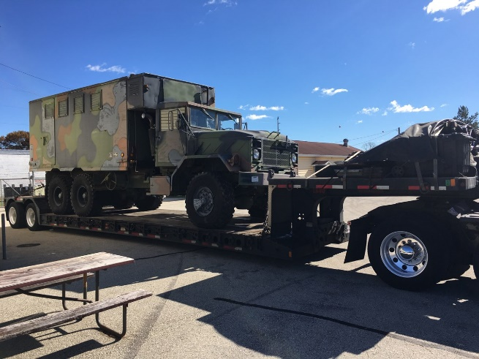
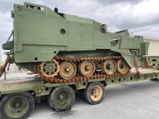
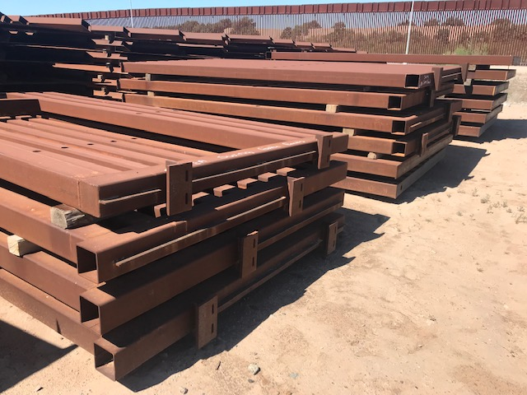
Reutilization/Transfer/Donation (R/T/D)
Excess
Surplus
Reutilization
Transfer
Donation
Military Services and
DOD Special Programs:
Law Enforcement
Foreign Military Sales
USDA, Firefighters
Humanitarian Assistance
Military Affiliate Radio System
Civil Air Patrol
ROTC Units
DOD/Service Museums
DOD Contractors
Computers for Learning
National Guard
MWR
Federal Civil Agencies:
U.S. Department of Agriculture
Forest Service
Veterans Affairs
Other Federal Agencies
National Association of State Agencies for Surplus Property:
Public Agencies
State and Local Governments
FY25 RTD Support To-Date:
73.8K Requisitions (1.7M items) Valued at $1.5B
Notes:
Slide updated 7/3/2025
FY25 so far we have processed 73,877 requisitions valued at $1,544,301,524. With the renewed focus on the RTD mission, acquisition values increased this fiscal year compared to the previous one.
Because we work for DOD, they must be our #1 mission, so just to give you a little Armed forces FY comparison: $388M Air Force, $234M Army, $104M Navy, $17M Marines, Coast Guard $988K;
High dollar Acq value items for the FY: (2320) Trucks and Tractors, (5859) Misc Communication equipment, (1550) Unmanned Aircraft armored vehicles (2355) combat assault vehicles.

Slide 7
Photo Required FSG’s & FSC’s
DLA Disposition Services Site employee will enter descriptive data and photo for items on RTD Web for usable inventory that has an acquisition value of $800 or above and is in condition code A-F/H for the following classes:
FSG 19: Ships, Small Craft, Pontoons, and Floating Docks.
FSG 23 & 24: Motor Vehicles, Trailers, Cycles.
FSG 34 – Large size Metalworking Machinery (welders, presses, and lathes) - Upon customer request through Additional Property Data (APD) Application.
FSG 38 – Construction, Mining, Excavating, Highway Maintenance Equip, (Bull Dozers, Front End Loaders, Backhoes, Rollers, Sweepers, Snow Removal Vehicles).
FSG 39 – Materials Handling Equipment.
FSG 42 – Fire Fighting, Rescue, and Safety Equipment; and Environmental Protection Equipment and Materials.
FSG 54 – Prefabricated Structures and Scaffolding (including relocatable buildings)
Federal Stock Class (FSC) 6115 – Generators and Generator Sets, Electrical Gasoline and Diesel.
FSC 6515 – Medical and Surgical Instruments, Equipment, and Supplies - Upon customer request through the APD section of RTD Web.
Commercially available items over $50,000 in A or B Condition with a Demilitarization (DEMIL) code of A, (various Integrity codes) or a DEMIL code of Q (integrity code of 6 only).
Property Received in Place. To include location in the Additional Property Data field, which will populate in the Description in PPMS.
7
Notes:
This is currently the list of Federal Supply Groups or Classes that our field sites are required to provide photos.
We have implemented a new change that photo’s will be required for Receipt in Place locations and they must include the physical address in the Additional Property Data.
In a couple slides I will go over the number of photos that are required and how we have been doing.

Slide 8
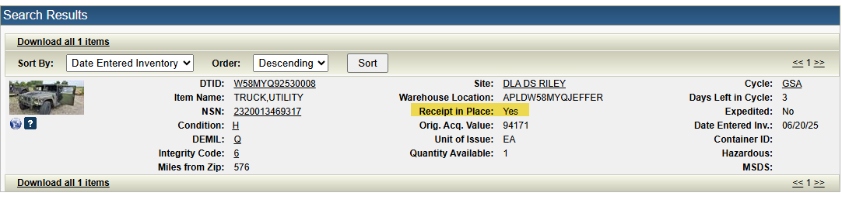
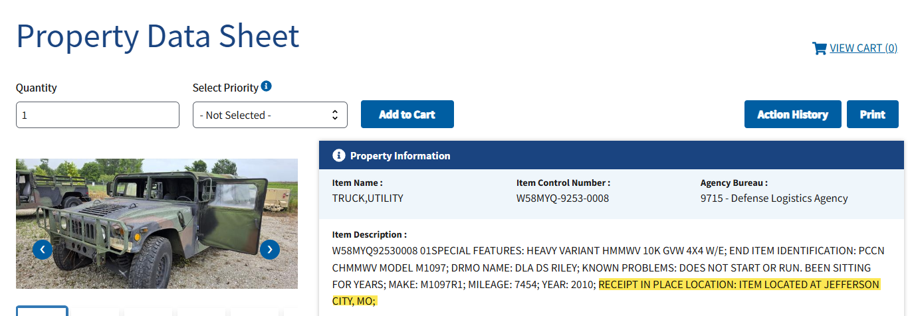
Receipt in Place-Photo Requirement
RTD WEB/PPMS
Notes:
Here you can see an item that it is showing on RTD Web as Receipt on Place. So when I went to PPMS to look for it, I would expect to see the RIP location. As you can see in the Item Description in PPMS, it shows the RIP location is Jefferson City MO.
If you have RTD Web access and are finding that they are showing as RIP in RTD Web and not showing the location in PPMS, then please provide me DTIDs while it is still on record so I can bring it to the Area Managers attention.
Or if you contact a field site to pick up and you find that it is RIP, immediately contact myself or Jennifer or the RTD Mailbox so we can make sure the

Slide 9
DLA Disposition Services-Photo’s
FY | # DTID’S Required Photo | #DTID’S Required Photos Taken | % Of Required Photos Taken | Total DTIDs With Photos
FY23 | 22,478 | 21,776 | 96.9% | 57,627
FY24 | 19,142 | 18,142 | 94.78% | 44,320
FY25 YTD | 9,200 | 8,761 | 76.77% | 22,385
Notes:
this chart shows the number of DTIDs that have been received for each FY that required a photo using the guidelines on the previous slide and then how many of those DTIDs we actually took photos for.
The last column shows how many photos we took, so above and beyond the requirement. We are taking over twice the amount of required photos.

Slide 10
RTD Updates
Strategic Plan (increase reut):
Top 50 FSCs flag in Electronic turn-in document (ETID)
Working on linking RTD Want Lists to ETID as well
Increase on-the-shelf rate by 50% increments
Scheduler
Fully deployed at Riley
Colorado Springs currently being deployed
Begin deploying by regions-November
Okta Portal
New login process for accessing RTD Web
10
Notes:
This FY Stategic Plan included quite a few RTD initiatives:
We took the top 50 FSC and when a turn in customer uses ETID to turn in property, it is going to notify our field sites that this property is in our Top 50 FSC, to encourage them to put on the shelf.
We are working on linking RTD Want List to ETID as well.
Working on ways to increase the on-the-shelf rate by 50% increments.
Scheduler Reminder:
If you are a SASP and are physically picking up property yourself:
The SASP will be required to schedule your own appointment using the “Automated Scheduler System”
If you are a SASP and are using transportation such as FedEX/UPS/ or a Trucking company/Broker
The SASP and/or Transportation company, whomever is arranging the pick-up appointment will contact the DLA Disposition Services field site. The site scheduler will enter the information into the “Automated Scheduler System”.
https://dlamil.dps.mil/sites/Dispo_Svcs_BIZSPT/SitePages/Disposition-Automated-Scheduler---Transportation-Management.aspx
For those of you that have view only access of RTD Web, Beginning August 9th, the login process for RTD Web will be updated to enhance security and streamline your access if you use more than one application (RTD, ETID, etc.). This change introduces the DLA Enterprise Single Sign-On (SSO) portal, also known as the Okta Portal. The new process will also incorporate Multi-Factor Authentication (MFA) as an additional layer of security to further protect your account. More detailed information regarding this change, including step-by-step instructions, will be shared via email and posted on the DLA webpage soon.

Slide 11
DLA Disposition Services
FY 25 YTD
FY 24
FY 23
 | Lines | Items | Acq Value | Lines | Items | Acq Value | Lines | Items | Acq Value
TOTAL DEMIL A&Q6 RECEIVED | 252K | 10M | $1.9B | 255K | 10M | $2.6B
REUTILIZATION/ SPECIAL PROGRAMS | 49.7K | 1.9M | $402M | 18K | 38.5K | 190M | 61K | 2B | $374M
TRANSFER | 1.4K | 21K | $18.4M | 1.1K | 15.9K | $12M | 5.2K | 791K | $61M
DONATION | 11.8K | 231K | $129M | 8.4K | 73K | $85M | 13.7K | 297K | 189.9M
Source: RTD Requisition On Going Report
As of June 2025
11
Notes:
FY25 THROUGH JUNE 2025
Reutilization numbers include all special programs as well AND I am only showing Demil A & Q6 Reut. CONUS to try to keep it as close to what transfer and donation customers are requesting.
This year I have included the amount of Demil A and Q 6 property we have received. Unfortuneately I was unable to pull FY 23 or prior. We have never been able to pull receipt data before now without going to our data team with a specific data request but they have created a new reporting system where we can pull a lot of data ourselves now.

Slide 12
Contact Information
DLA RTD
DSDs
RTD Branch Chief – Vacant
Cassie Gilbert – (269) 762-3942 – Casandra.Gilbert@dla.mil
Jennifer Geairn – (269) 213-7534 – Jennifer.Geairn@dla.mil
RTD MAILBOX: DispSvcsRTD@dla.mil
DSD North East – Beth Ford– (804) 279-6572 – Beth.Ford@dla.mil
DSD South East – Becky Watson– (904) 661-5006 – Becky.Watson@dla.mil
DSD Mid-America – Jessie Parisano – (210) 780-4961- Jessie.Parisano@dla.mil
DSD West – Christopher Buchanan – (619) 512-0519 – Christopher.Buchanan@dla.mil
DSD Pacific – Faron Cordrey – (808) 786-2006 – Faron.Cordrey@dla.mil

Slide 13

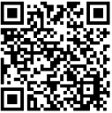
Scan App
Digital DSR Web Page
Scan App
RTD
Web Page

